Slide 1

Genetic counseling in hereditary neuropathy
Rahbar, M, MD
Physiatrist
Tabriz University of Medical Science

Slide 2
Hereditary neuropathy
Genetically heterogeneous group of neuropathies
  >100 genes identified
Characterized by a common clinical phenotype
  homogeneous clinical phenotype
    Progressive peroneal muscular atrophy, hand muscle atrophy
    Skeletal deformities (including pes cavus)
    Usually decrease or absence of tendon reflexes
    Variation in clinical presentation
An accurate diagnosis (not always easy) by
  Genetic analysis
    May be orientated by electro-clinical, biological and sometimes pathological signs (with sometimes specific signs function of the genes)

Slide 3
Categories of Hereditary neuropathies
By involvement of motor, sensory and/or autonomic nerve fibers (Dyck et al., 2005)
  Hereditary motor and sensory neuropathies (HMSN), also known as Charcot-Marie-Tooth (CMT) disease
    Prevalence : 1 in 2500 individuals
  Hereditary neuropathy with liability to pressure palsies (HNPP)
  Distal hereditary motor neuropathy (dHMN)
  Hereditary sensory and autonomic neuropathy (HSAN)
Hereditary Neuropathy
CMT
HNPP
HSAN
dHMN

Slide 5
Charcot-Marie Tooth disease (CMT)-TYPES
CMT1 (Hypertrophic demyelinating)
CMT2 (Axonal)
CMT3 (Dejerine-sotta’s disease)
CMT4 (Refsum’s disease-AR)
CMT5 (Spastic Paraplegia)
CMT6 (Optic Atrophy)
CMT7 (Retinitis Pigmentosa)

Slide 6
Classification of CMT
Age of onset
  Infantile (delayed walking), childhood, or adult
Mode of inheritance (crucial information for diagnostic purposes and genetic counseling)
  AD (autosomal dominant)
  AR (autosomal recessive)
  XL (X-linked)
  Spo (sporadic forms)
  Mit (mitochondrial inheritance)
The second module corresponds to the phenotype and electrophysiology
  CMT
    Demyelinating, or type “1”,
    Axonal, or type “2”
    Intermediate
Name of the gene
  involved in the disease (with the possibility of putting the term “Unknown” in case of an unknown or as-yet undiscovered gene or mutation).

Slide 9
GENETIC TESTING STRATEGIES
Testing guidelines
  Age of onset: infantile (delayed walking), childhood, or adult
  MNCV guidelines
    MNCV
      Demyelinating
        ≤ 15 m/s (very slow)
        15 < and ≤ 35 m/s (slow)
        >35 and ≤ 45 m/s (intermediate)
      Axonal CMT: MNCV > 45 m/s or Unobtainable CMAP
    Specific gene for CMT subtypes panels
Whole-exome and/or whole-genome sequencing

Slide 16
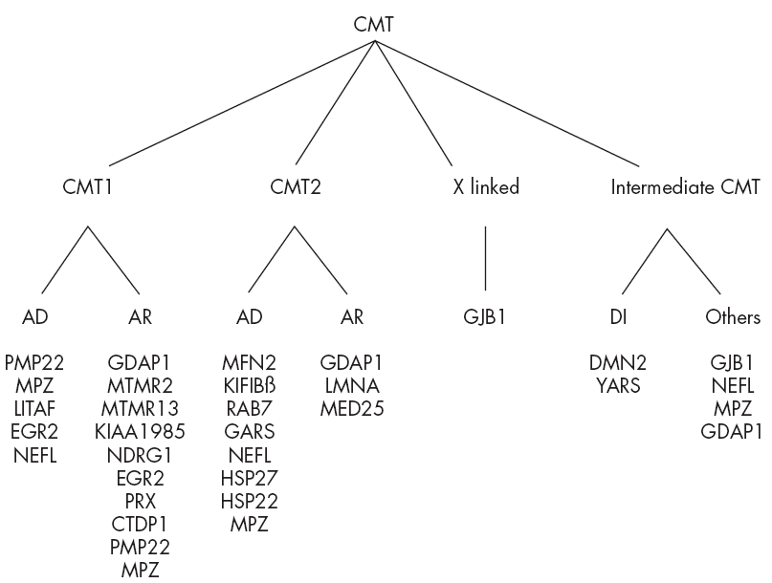
CMT - genotypes

Slide 18
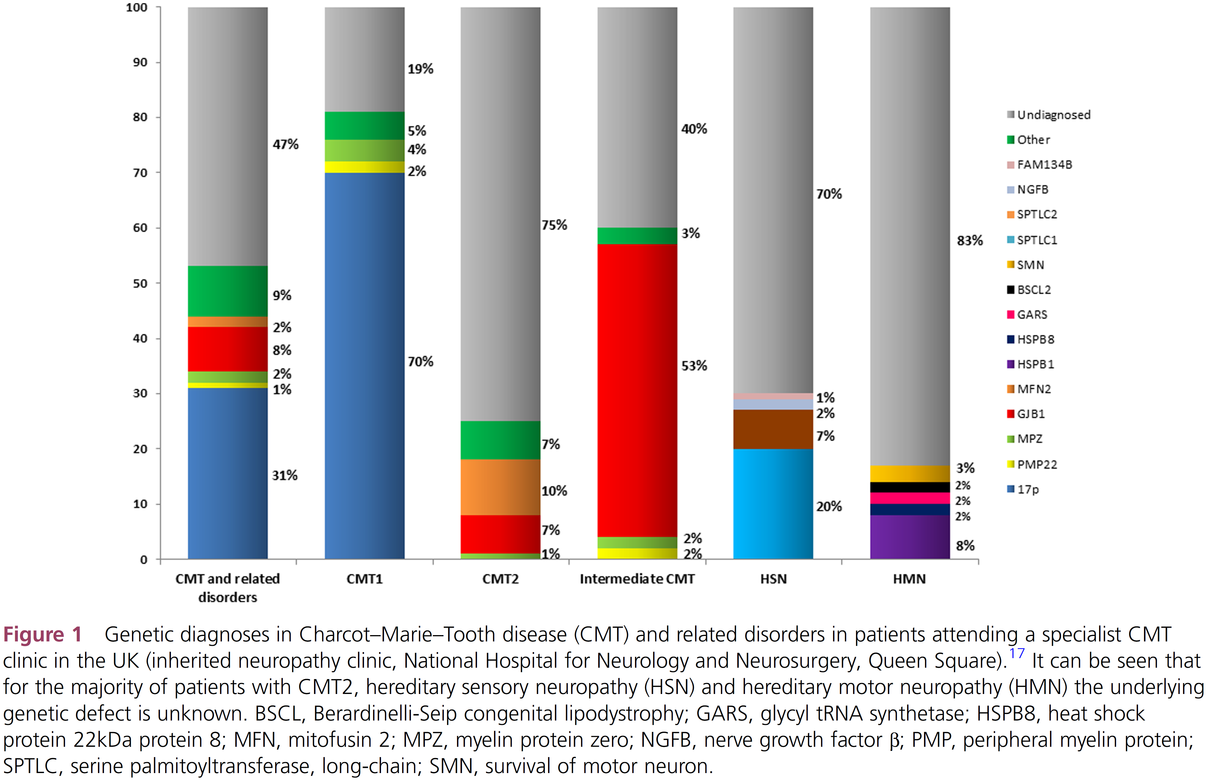

Slide 21
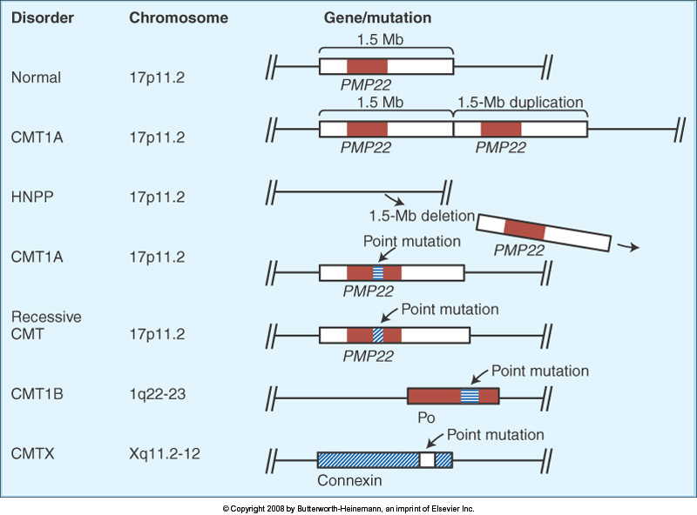

Slide 26
Pros and cons for genetic testing
Not every patient with a genetic neuropathy wants or needs testing to identify the genetic cause of their disease.
The ultimate decision to undergo genetic testing rests with the patient or the patient’s parents if a symptomatic child is under 18 years of age
Reasons that patients given for obtaining testing
  identifying the inheritance pattern of their CMT
  making family planning decisions
  obtaining knowledge about the cause and natural history of their form of CMT
  Natural history data is available for some forms of CMT such as CMT1A and CMT1X, which can provide guidance for prognosis, recognizing that there can be phenotypic variability in these subtypes.
    Patients with other forms of CMT frequently choose to undergo genetic testing to contribute to the natural history data collection for other patients with the same subtype

Slide 27
Pros and cons for genetic testing
Reasons why patients do not want genetic testing
  The high costs of commercial testing
  Fears of discrimination in the workplace or in obtaining health insurance.
  Since there are currently no medications to reverse any form of CMT, many patients decide against testing since their therapies will not depend on the results.
Whether or not to pursue genetic testing is always the patient’s decision
Notes:
Once a genetic diagnosis has been made in a patient, other family members usually do not need genetic testing but can be identified by clinical evaluation with neurophysiology. We do not typically test patients for multiple genetic causes of CMT simultaneously, although we did identify patients with multiple genetic causes of CMT. It is our current policy to only consider performing genetic testing in clinically affected family members of a proband if their phenotype is atypical for the type of CMT in the family. In addition, we do not test asymptomatic minors with a family history of CMT, either by electrophysiology or genetic testing, due to the chance for increased psychological harm to the child. 29 We do routinely perform limited nerve conduction studies, though not needle EMG, on symptomatic children with CMT. Since nerve conduction changes, including slowing, are often uniform and detectable in early childhood in CMT 17,18, testing of a single nerve is often adequate to guide genetic testing or determine whether a symptomatic child is affected in a family with CMT

Slide 28
KEY POINTS
Identifiable genetic causes of neuropathy elucidate biological pathways that cause demyelination or axonal loss.
Charcot Marie Tooth disease is genetically and clinically heterogeneous with >100 genes causing neuropathy that can vary in age of onset and severity.
Mutations in just 4 genes (PMP22, GJB1, MPZ and MFN2) cause >90% of the genetically identifiable cases of CMT in North America.
Combining the clinical phenotype and nerve conduction velocities in the arm can further focus genetic testing among these four genes.
Because CMT can affect family members other than the proband we suggest that genetic counseling be considered for patients and their families

Slide 29
Thank you for lisstening

